Slide 1

Historical Summer Olympic Analysis
By:
Julian Kim, Brandon Hayes, Fei Meng, and Rosa Munoz

Slide 2
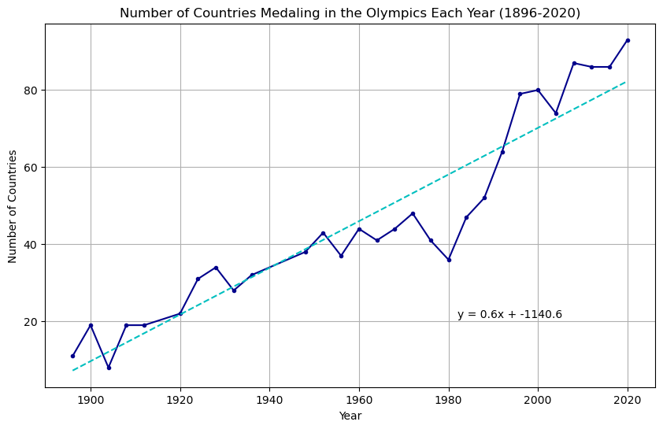
How has the addition of new countries affected the Olympics?

Slide 3
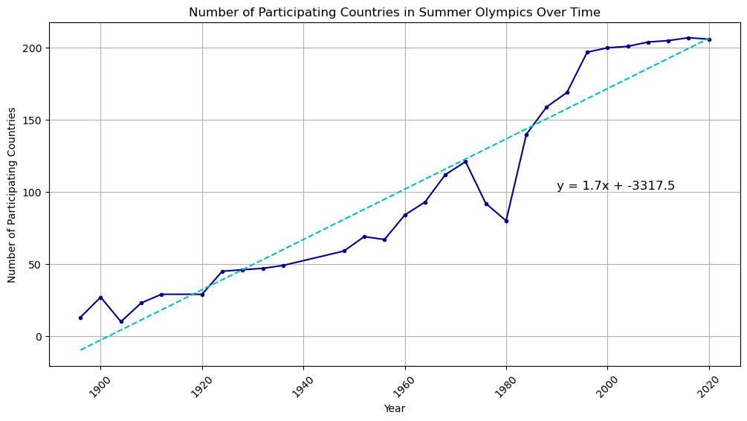
How has the addition of new countries affected the Olympics? (part 2)

Slide 4
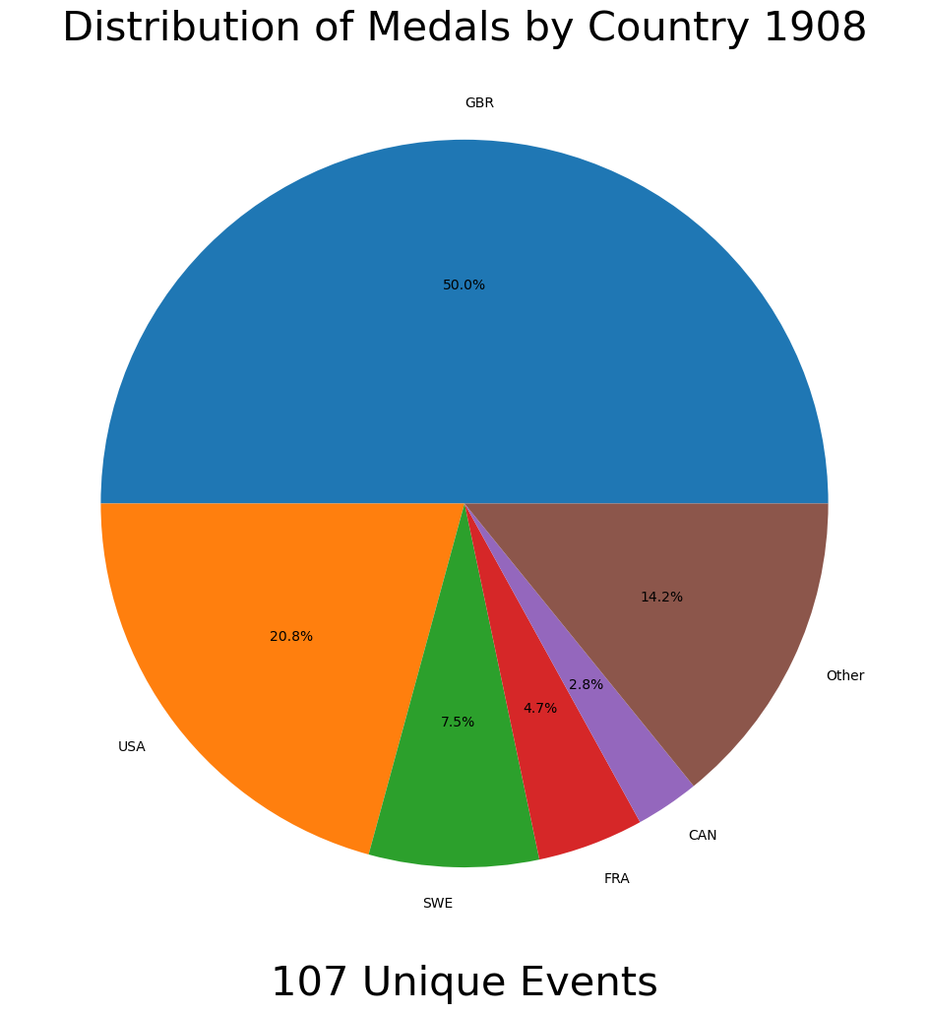
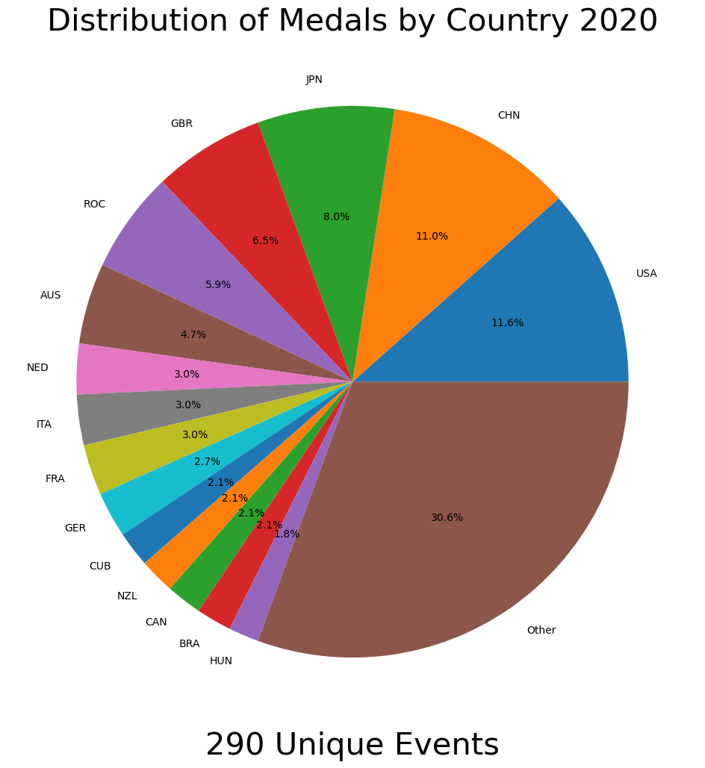
How has the addition of new events affected the Olympics?

Slide 5
How has the addition of new events affected the Olympics? (part 2)

Slide 6
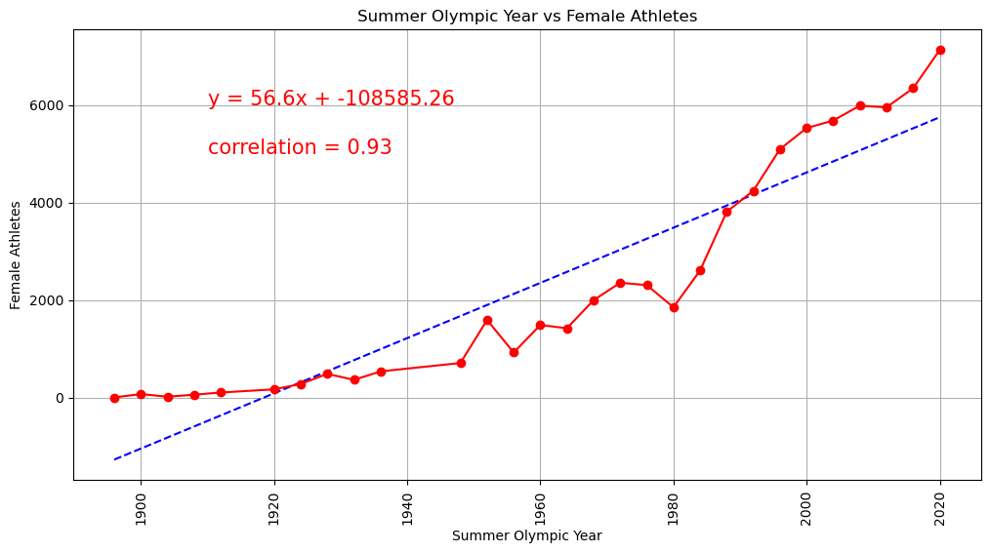
Have there been more female athletes added over time?

Slide 7
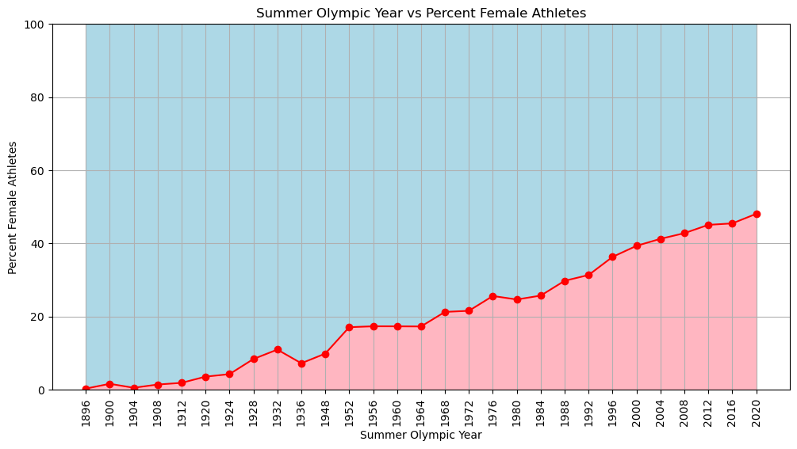
Have there been more female athletes added over time? (Part 2)

Slide 8
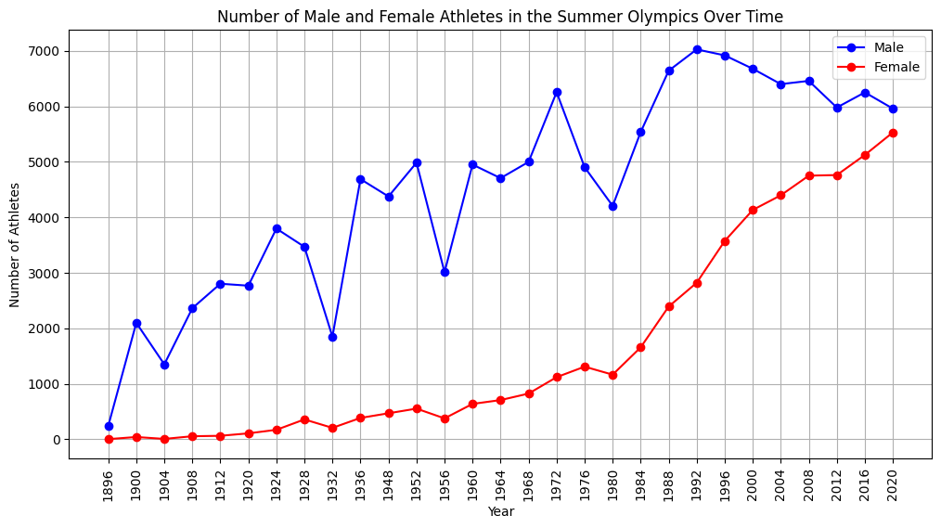
Have there been more female athletes added over time? (Part 3)

Slide 9

References
https://www.kaggle.com/datasets/muhammadehsan000/olympic-historical-dataset-1896-2020?select=Olympic_Athlete_Bio.csv
Olympic_Athlete_Bio.csv
Olympic_Athlete_Event_Results.csv
Olympic_Games_Medal_Tally.csv
Olympic_Results.csv
Olympics_Country.csv
Olympics_Games.csv

